Slide 1
Capstone Project - 2
TED TALK View Prediction
By:-Md Amanatullah

Slide 2
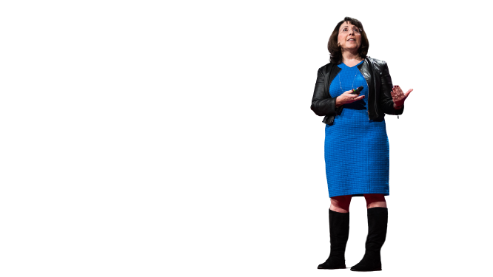

Let’s Predict The Daily Views Of Ted Talk
Defining problem statement
EDA and feature engineering
Feature Selection
Preparing dataset for modeling
Applying Model
Model Validation and Selection

Slide 3

The Dilemma
What Is A TED Talk?
To get right to business, a TED talk is a short presentation that focuses on technology, entertainment, and/or design. To put it another way, TED is a non-profit institution that partners with individuals to assist in sharing ideas globally. Today, TED boasts a collection of over 3,000 TED talk videos from politicians to scientists to comedians and actors. Additionally, they add new videos day in and day out, so there’s never a shortage of engaging content.

Slide 4
Data Pipeline
Data processing-1: In this first part we’ve removed unnecessary features.
Since there were nearly many columns with all null values.
Data processing-2: In this part, we manually go through each features selected from part 1, And encoded the categorical features ,changed the columns containing date time values .
EDA: In in this part, we do some exploratory data analysis (EDA) on the features selected in part-1 and 2 to see the trend.
Create a model: Finally, In this last but not the last part, we create models. Creating a model is also not an easy task. It’s also an iterative process. we show how to start with a with a simple model, then slowly add complexity for better performance.

Slide 5
Data Summary
TED TALK DATA
CATEGORICAL
TARGET
NUMERIC
title
VI
views
UNIQUE
talk_id
speaker_1
talk_id
views
all_speakers
comments
occupations
duration
about_speakers
recorded_date
published_date
event

Slide 6

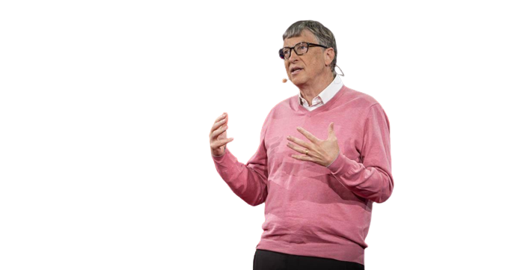
Data Summary
'talk_id'=Special unique id given to each talk.
'title'=Title of the talk.
'speaker_1'=Main speaker of the talk.
'all_speakers'=Other speakers along with main speaker
'occupations'=Occupation of the speaker.
'about_speakers'=Some achievements of speaker.
'views'=Total no. of views recorded.
'native_lang'=The original language in which talk was recorded.
'available_lang'=The other languages in which the talk is available.
‘comments’=The total no. of responses by viewers

Slide 7
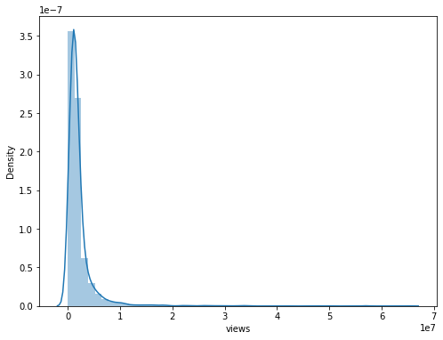
EDA
Distribution Plot Of Numeric Feature views.

Slide 8
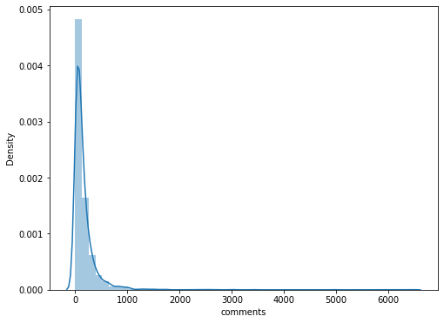
EDA
Distribution Plot Of Numeric Feature comments.

Slide 9
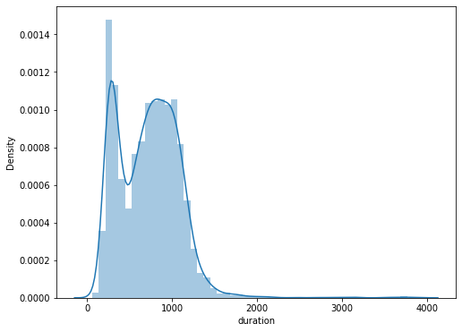
EDA
Distribution Plot Of Numeric Feature duration.

Slide 10
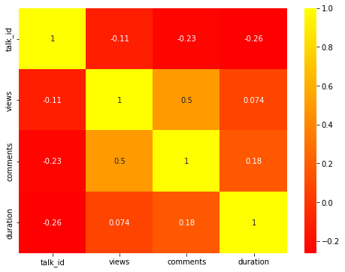
EDA
Checking Correlation Between The Numeric Features Through Heatmap

Slide 11
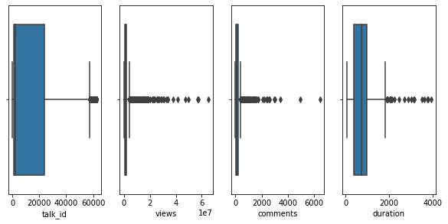
EDA
Checking Outliers Of The Numeric Features Through Boxplot

Slide 12
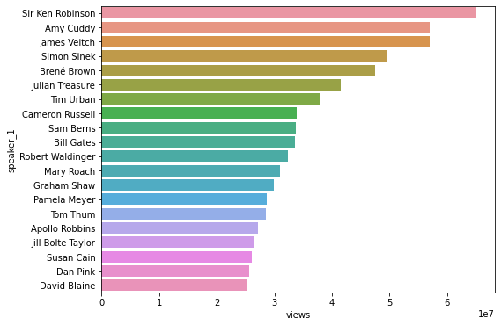
EDA
Top Speakers Which Have Got The Most Views Descending Order

Slide 13
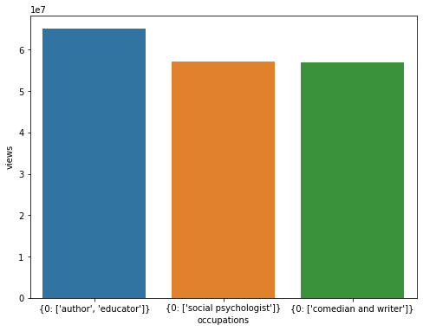
EDA
The Occupation Of Top Three Speakers With Most Views

Slide 14
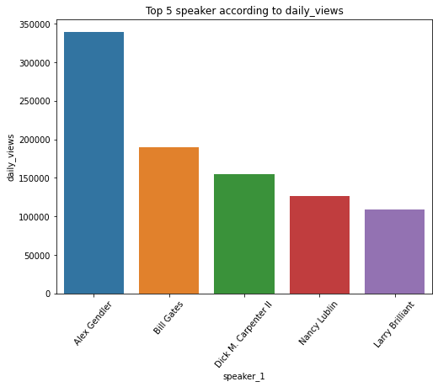
EDA

Slide 15
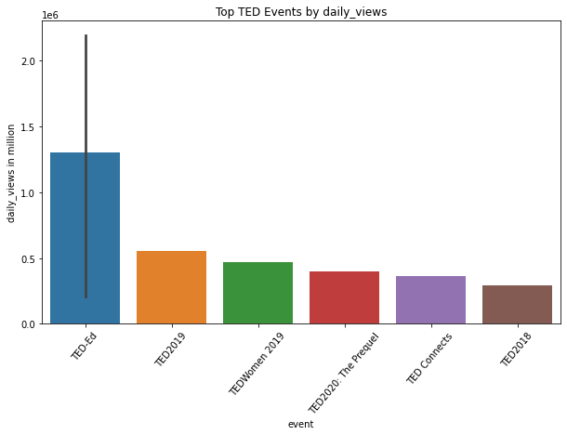
EDA

Slide 16
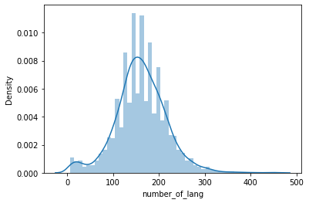
EDA
Density plot of available language column

Slide 17
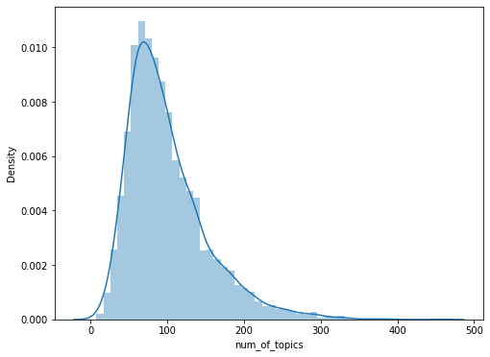
EDA
Density plot of num of topics

Slide 18
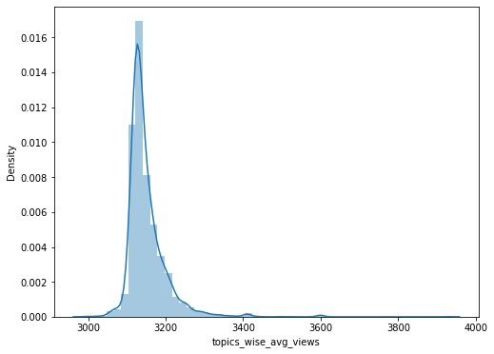
EDA

Slide 19
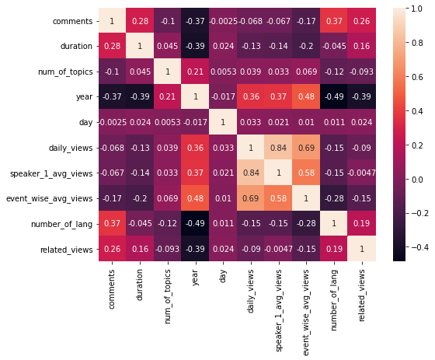
EDA
Checking Collinearity Of The Selected Features On which We Have To Train Or Test The Model

Slide 20
Preparing dataset for modeling
Task:-LinearRegression
Response:-daily_views
Train Set:-(2803,28)
Test Set:-(1202,28)
comments | duration | num_of_topics | year | day | speaker_1_avg_views | event_wise_avg_views | number_of_lang | related_views | month_Apr | ... | month_Nov | month_Oct | month_Sep | week_day_Fri | week_day_Mon | week_day_Sat | week_day_Sun | week_day_Thu | week_day_Tue | week_day_Wed
0 | 272.0 | 977.0 | 134 | 2006 | 27 | 699.725014 | 782.728890 | 270.000000 | 3093 | 0 | ... | 0 | 0 | 0 | 0 | 0 | 0 | 0 | 0 | 1 | 0
1 | 628.0 | 1190.0 | 138 | 2006 | 27 | 1098.925286 | 782.728890 | 160.720599 | 865 | 0 | ... | 0 | 0 | 0 | 0 | 0 | 0 | 0 | 0 | 1 | 0

Slide 21
Applying Model (Baseline Model)
Evaluation Metrics(LinearRegression)
Training Set(Evaluation Metrics)
MSE is 14106608.72821187
RMSE is 3755.8765592351238
RMSE is 0.7528239257572826
MAE is 1237.0240155676581
MAPE is inf
R2_score is 0.7528239257572826

Slide 22
Applying Model (Baseline Model)
Evaluation Metrics(LinearRegression)
Testing Set(Evaluation Metrics)
MSE is 8942877.122877667
RMSE is 2990.4643657595498
RMSE is 0.8293605444841214
MAE is 1195.0153404994978
MAPE is 188.49873115144536
R2_SCORE is 0.8293605444841214

Slide 23
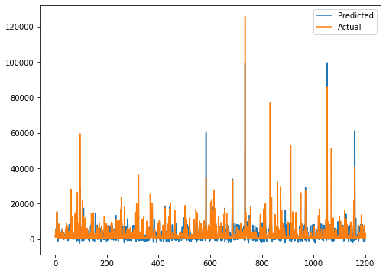
Predicted Vs Actual Plot On Test Data
LinearRegression

Slide 24
Lasso Regression and Cross Validation
The best fit alpha value is found out to be : {'alpha': 1e-15}
Using {'alpha': 1e-15} the negative mean squared error is: -32912019.291003287
MSE : 20880106.726031132
RMSE : 4569.475541682123
R2 : 0.6015857096226229

Slide 25
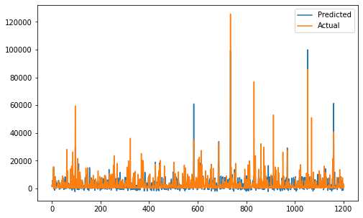
Predicted Vs Actual Plot On Test Data
Lasso Regression

Slide 26
Ridge Regression and Cross Validation
The best fit alpha value is found out to be : {'alpha': 1e-15}
Using {'alpha': 1e-15} the negative mean squared error is: -32912019.291003305
MSE : 20880106.72603111
RMSE : 4569.475541682121
R2 : 0.6015857096226233

Slide 27
Predicted Vs Actual Plot On Test Data
Ridge Regression

Slide 28
Conclusion
That's it! We reached the end of our exercise.
Started with loading the data so far we have done EDA ,feature engineering , data cleaning, target encoding and one hot encoding of categorical columns, feature selection and then model building.
So far we have modelled on
1.LinearRegression
2.Lasso Regression
3.Ridge Regression
In all of these models our errors have been in the range of 2,00,000 which is around 10% of the average views. We have been able to correctly predict views 90% of the time. After hyper parameter tuning, we have prevented overfitting and decreased errors by regularizing and reducing learning rate. Given that only have 10% errors, our models have performed very well on unseen data due to various factors like feature selection,correct model selection,etc.
In all the features speaker_wise_avg_views is most important this implies that speakers are directly impacting the views.

